Slide 1

6
JAVA PROGRAMMING
ATM Transaction
Simulator
Course-outcome modules
14
Menu operations
Student Name: Laasya Roll No: 2620030160
1
Text file record store
1
Notes:
1

Slide 2
PROJECT OVERVIEW
Abstract
A menu-driven Java application that simulates common ATM banking transactions and records account activity.
WHAT THE SYSTEM DOES
JAVA CONCEPTS IN PRACTICE
The ATM simulator lets users check their balance, deposit and withdraw money, review transaction history, search and sort transactions, generate reports, and read saved records.
The code demonstrates Java fundamentals, control flow, methods, recursion, arrays, object-oriented programming, exception handling, strings, file I/O, collections, lambda expressions, and streams.
Core goal: simulate transactions and organize account records using Java.
ATM Transaction Simulator
2
Notes:
2

Slide 3
PROBLEM & SOLUTION
Understanding the Problem Statement
Why routine banking operations benefit from clear transaction processing.
THE PROBLEM
OUR SOLUTION
Tracking deposits, withdrawals, balances, and previous transactions manually can be error-prone and make account activity harder to review.
A menu-driven Java program validates transaction amounts, updates the balance, records transaction details, supports search and sorting, and saves records to a text file.
MAIN FUNCTIONS
01
02
03
04
Check balance
Deposit / withdraw
Search / sort history
Save / view records
ATM Transaction Simulator
3
Notes:
3

Slide 4
COURSE OUTCOMES
Six Modules at a Glance
How each Java module maps to a part of the ATM simulator.
MODULE | TITLE | KEY TOPICS IN THE ATM CODE
CO 1 | From Problem to Program | Variables, constants, operators, Scanner input, formatted output, input checks
CO 2 | Control Flow: Selection & Iteration | if, switch, while, do-while, for loops, break & continue
CO 3 | Methods, Recursion & Arrays | Modular methods, overloading, 1D/2D arrays, binary search, recursion
CO 4 | OOP Modelling & Exception Handling | Classes, inheritance, abstract classes, interfaces, exceptions
CO 5 | Strings, Algorithms & File I/O | String operations, searching & sorting, Comparable, file reading & writing
CO 6 | Functional Programming & Collections | ArrayList, HashMap, HashSet, lambdas, method references, streams
ATM Transaction Simulator
4
Notes:
4

Slide 5
CO 1 / MODULE 1
CO 1 | From Problem to Program
Computational Thinking & Java Foundations
# | TOPIC USED | PURPOSE IN OUR CODE
01 | Variables & data types | Store transaction amounts, account balance, menu choices, and transaction counts.
02 | Constants | TITLE stores the application heading; FILE stores the transaction file name.
03 | Arithmetic & assignment operators | Update balance after deposits and withdrawals; add amounts to transaction summaries.
04 | Relational operators & conditions | Validate positive amounts, check sufficient balance, and test whether the user chose Exit.
05 | Scanner input & formatted output | Scanner reads menu choices and amounts; printf displays the balance to two decimal places.
06 | Exception and input checks | Check numeric input and handle invalid transaction amounts or insufficient balance.
ATM Transaction Simulator
5
Notes:
5

Slide 6
CO 2 / MODULE 2
CO 2 | Control Flow: Selection & Iteration
Decisions and repetition that drive the ATM menu
# | TOPIC USED | PURPOSE IN OUR CODE
01 | if conditions | Reject non-positive deposits or withdrawals and prevent withdrawals above the balance.
02 | switch, case & default | Route choices to balance, deposit, withdrawal, history, search, reports, demonstrations, or exit.
03 | while loop | Check that the menu choice is an integer and discard invalid input.
04 | do-while loop | Repeat the ATM menu until the user enters 0 to exit.
05 | for and collection loops | Traverse transactions and print history, sorted records, and report details.
06 | break & continue | Use break to leave switch cases and continue to re-prompt after invalid menu input.
ATM Transaction Simulator
6
Notes:
6

Slide 7
CO 3 / MODULE 3
CO 3 | Methods, Recursion & Arrays
Decomposition with Methods, Recursion & Arrays
# | TOPIC USED | PURPOSE IN OUR CODE
01 | Modular methods | Separate deposits, withdrawals, history, search, sorting, reports, and file operations into methods.
02 | Parameters & return values | Pass amounts and transaction objects; return the current balance and recursive transaction total.
03 | Method overloading | receipt(String) displays a message; receipt(Transaction) displays a transaction receipt.
04 | 1D arrays: sort & search | Convert transaction amounts to a double array, sort them, and search using Arrays.binarySearch().
05 | Recursion | recursiveTotal(index) adds transaction amounts and stops when the index reaches history.size().
06 | 2D arrays and counting | matrixReport() counts deposits and withdrawals and totals their amounts in a 2D array.
ATM Transaction Simulator
7
Notes:
7

Slide 8
CO 4 / MODULE 4
CO 4 | OOP Modelling & Exception Handling
Object-Oriented Modelling, Design & Exception Handling
# | TOPIC USED | PURPOSE IN OUR CODE
01 | Classes & objects | BankAccount stores account state and transaction collections; Transaction models each recorded transaction.
02 | Constructors & overloading | Constructors initialize a BankAccount balance and Transaction type, amount, and balance.
03 | Encapsulation & accessors | Private transaction fields are accessed through getType(), getAmount(), and getBalance().
04 | Inheritance & abstract class | Transaction extends the abstract TransactionAction class and implements its required transaction type behaviour.
05 | Interfaces & overriding | ATMOperations defines deposit/withdraw; Comparable orders transactions by amount; methods are overridden.
06 | Exceptions & try-with-resources | Handle invalid amounts, input mismatches, and file errors; try-with-resources closes file writers/readers.
ATM Transaction Simulator
8
Notes:
8

Slide 9
CO 5 / MODULE 5
CO 5 | Strings, Algorithms & File I/O
Strings, Library Algorithms & File I/O
# | TOPIC USED | PURPOSE IN OUR CODE
01 | String operations & validation | Trim search keywords, split saved records, check text content, and compare transaction types ignoring case.
02 | Concatenation & case conversion | Build transaction records and messages; demonstrate uppercase conversion and StringBuilder/StringBuffer.
03 | Searching & sorting algorithms | Filter history by transaction type, sort by amount, and binary-search sorted transaction amounts.
04 | Comparable interface | Transaction.compareTo() compares transaction amounts for natural ordering.
05 | Files, Path & buffered writing | Append transaction type, amount, and resulting balance to transactions.txt.
06 | Reading files & exception handling | Check file existence, read records line by line or as streams, and handle I/O or malformed data.
ATM Transaction Simulator
9
Notes:
9

Slide 10
CO 6 / MODULE 6
CO 6 | Functional Programming & Collections
Functional Programming with Collections & Streams
# | TOPIC USED | PURPOSE IN OUR CODE
01 | ArrayList, HashMap & HashSet | ArrayList stores history; HashMap counts transaction types; HashSet stores unique types.
02 | Generics & typed collections | Use typed collections such as ArrayList<Transaction>, HashMap<String, Integer>, and HashSet<String>.
03 | Lambda expressions & functional interfaces | Predicate filters transaction types; Function maps amounts; Supplier returns an ATM-ready message; Consumer displays output.
04 | Method references | Use references such as System.out::println and Transaction::getAmount in stream operations.
05 | Stream filter, map & collect | Filter deposits, map transaction amounts, and collect grouped transaction counts.
06 | Collectors & file streams | Group transactions by type, join category names, and count saved records using file streams.
ATM Transaction Simulator
10
Notes:
10

Slide 11
WRAP-UP
Conclusion
What the project demonstrates.
PROJECT OUTCOME
POSSIBLE FUTURE IMPROVEMENTS
The simulator supports balance checking, deposits, withdrawals, transaction history, searching, sorting, reports, and file storage. It connects Java topics from six modules to a banking-style application.
Add PIN authentication, a graphical interface, account profiles, database storage, encrypted records, transaction limits, and downloadable statements.
Overall, the project applies core Java concepts to simulate banking transactions and organize account activity.
11
Notes:
11

Slide 12
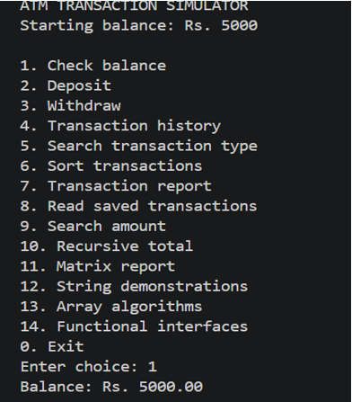
PROJECT EVIDENCE
Output Screenshots
ATM Transaction Simulator
12
Notes:
12

Slide 13
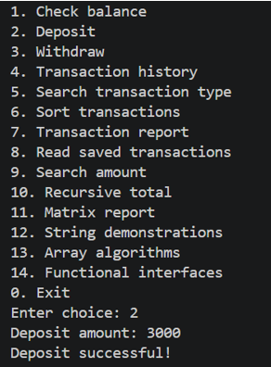

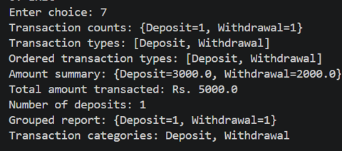


PROJECT EVIDENCE
ATM Transaction Simulator
13
Notes:
13

Slide 14
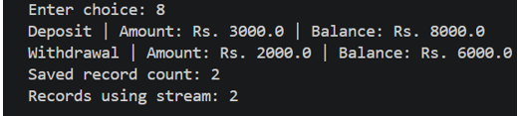

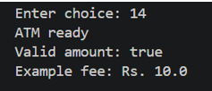

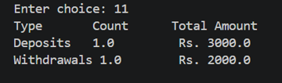

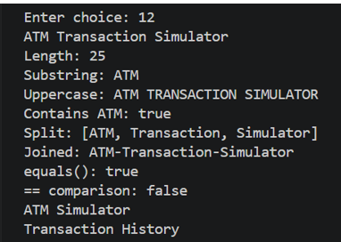
PROJECT EVIDENCE
14
Notes:
14

Slide 15
SOURCE CODE
GitHub Repository
https://github.com/surepallilaasya/JAVA-project1
Project source: ATM.java
15
Notes:
15

